Slide 1
General Requirements Elicitation
Chapter 4

Slide 2
Some Questions and Answers
What is it?
Requirements engineering helps software engineers to better understand the problem they will work to solve
Who does it?
Software Engineers, Clients, Project managers, End- users, Customers
Why is it important?
Designing and building a computer program that doesn’t solve the customers problem serve no one. That is why it is important
What are the steps?
Inception, elicitation, elaboration Negotiation, Specification, validation, Requirement Management.

Slide 3
Requirements Elicitation
A requirement is a feature that the system must have
Requirement Elicitation is about communication among developers, clients, and end-users to define a new system
Requirement Engineering aims to defining the requirements of the system under construction
Requirement Engineering includes two main activities:
Requirement elicitation: specification of the system that the client understand
Analysis is an model that the developer can clearly interpret

Slide 4
Requirement Elicitation Concepts
Functional requirements
Nonfunctional requirements
Completeness, consistency, clarity, and correctness
Realism, verifiability, traceability
Greenfield engineering, reengineering, interface engineering

Slide 5
Scenario and Use cases
Scenario describes an example of system use in terms of a series of interactions between the use and the system
a scenario is a narrative description of what people do and experience when they try to use a system
Use case is an abstraction that describes a class of scenarios

Slide 6
A Typical Example of Software Lifecycle Activities
Requirements
Elicitation
Analysis
System
Design
Detailed
Design
Implemen-
tation
Testing

Slide 7
Software Lifecycle Activities
...and their models
Requirements
Elicitation
Analysis
System
Design
Detailed
Design
Implemen-
tation
Testing
Use Case
Model

Slide 8
Software Lifecycle Activities
...and their models
Requirements
Elicitation
Analysis
System
Design
Detailed
Design
Implemen-
tation
Testing
Expressed in terms of
Use Case
Model
Application
Domain
Objects

Slide 9
Software Lifecycle Activities
...and their models
Requirements
Elicitation
Analysis
System
Design
Detailed
Design
Implemen-
tation
Testing
Expressed in terms of
Structured by
Use Case
Model
Application
Domain
Objects
Sub-
systems

Slide 10
Software Lifecycle Activities
...and their models
Requirements
Elicitation
Analysis
System
Design
Detailed
Design
Implemen-
tation
Testing
Expressed in terms of
Structured by
Realized by
Use Case
Model
Application
Domain
Objects
Solution Domain
Objects
Sub-
systems

Slide 11
Software Lifecycle Activities
...and their models
Requirements
Elicitation
Analysis
System
Design
Detailed
Design
Implemen-
tation
Testing
Implemented by
Expressed in terms of
Structured by
Realized by
class...
class...
class...
Use Case
Model
Application
Domain
Objects
Solution Domain
Objects
Sub-
systems
Source
Code

Slide 12
Software Lifecycle Activities
...and their models
Requirements
Elicitation
Analysis
System
Design
Detailed
Design
Implemen-
tation
Testing
Implemented by
Expressed in terms of
Structured by
Realized by
Verified
By
class...
class...
class...
?
?
class....
Use Case
Model
Application
Domain
Objects
Solution Domain
Objects
Sub-
systems
Source
Code
Test
Case
Model

Slide 13
Software Lifecycle Activities
Requirements
Elicitation
Analysis
System
Design
Detailed
Design
Implemen-
tation
Testing
Implemented
By
Expressed in Terms Of
Structured By
Realized By
Verified
By
class...
class...
class...
?
class....
?
Use Case
Model
Application
Domain
Objects
Solution Domain
Objects
Subsystems
Source
Code
Test
Case Model

Slide 14
First step in identifying the Requirements: System identification
Two questions need to be answered:
How can we identify the purpose of a system?
What are the requirements, what are the constraints?
What is inside, what is outside the system?
These two questions are answered during requirements elicitation and analysis
Requirements elicitation:
Definition of the system in terms understood by the customer and/or user (“Requirements specification”)
Analysis:
Definition of the system in terms understood by the developer (Technical specification, “Analysis model”)
Requirements Process: Consists of the activities Requirements Elicitation and Analysis.

Slide 15
Techniques to elicit Requirements
Bridging the gap between end user and developer:
Questionnaires: Asking the end user a list of pre-selected questions
Task Analysis: Observing end users in their operational environment
Scenarios: Describe the use of the system as a series of interactions between a specific end user and the system
Use cases: Abstractions that describe a class of scenarios.

Slide 16
Scenarios
Scenario
A synthetic description of an event or series of actions and events
A textual description of the usage of a system. The description is written from an end user’s point of view
A scenario can include text, video, pictures and story boards. It usually also contains details about the work place, social situations and resource constraints.

Slide 17
More Definitions
Scenario: “A narrative description of what people do and experience as they try to make use of computer systems and applications”
[M. Carroll, Scenario-Based Design, Wiley, 1995]
A concrete, focused, informal description of a single feature of the system used by a single actor
Scenario become the basis of interaction for a new design or allow better understanding of the new design.

Slide 18
Scenario-Based Design
Scenarios can have many different uses during the software lifecycle
Requirements Elicitation: As-is scenario, visionary scenario
Client Acceptance Test: Evaluation scenario
System Deployment: Training scenario
Scenario-Based Design: The use of scenarios in a software lifecycle activity
Scenario-based design is iterative
Each scenario should be considered as a work document to be augmented and rearranged (“iterated upon”) when the requirements, the client acceptance criteria or the deployment situation changes.

Slide 19
Scenario-based Design
Focuses on concrete descriptions and particular instances, not abstract generic ideas
It is work driven not technology driven
It is open-ended, it does not try to be complete
It is informal, not formal and rigorous
Is about envisioned outcomes, not about specified outcomes.

Slide 20
How do we find scenarios?
Don’t expect the client to be verbose if the system does not exist
Client understands the application domain (problem domain), not the solution domain
Don’t wait for information even if the system exists
“What is obvious does not need to be said”
Engage in a dialectic approach
You help the client to formulate the requirements
The client helps you to understand the requirements
The requirements evolve while the scenarios are being developed.

Slide 21
Heuristics for finding scenarios
Ask yourself or the client the following questions:
What are the primary tasks that the system needs to perform?
What data will the actor create, store, change, remove or add in the system?
What external changes does the system need to know about?
What changes or events will the actor of the system need to be informed about?
However, don’t rely on questions and questionnaires alone
Insist on task observation if the system already exists (interface engineering or reengineering)
Ask to speak to the end user, not just to the client
Expect resistance and try to overcome it.

Slide 22
Scenario example: Warehouse on Fire
Bob, driving down main street in his patrol car notices smoke coming out of a warehouse. His partner, Alice, reports the emergency from her car.
Alice enters the address of the building into her wearable computer , a brief description of its location (i.e., north west corner), and an emergency level.
She confirms her input and waits for an acknowledgment;
John, the dispatcher, is alerted to the emergency by a beep of his workstation. He reviews the information submitted by Alice and acknowledges the report. He allocates a fire unit and sends the estimated arrival time (ETA) to Alice.
Alice received the acknowledgment and the ETA..

Slide 23
Observations about the Warehouse on Fire Scenario
It is a concrete scenario
It describes a single instance of reporting a fire incident
It does not describe all possible situations in which a fire can be reported
Participating actors
Bob, Alice and John.
Notes:
What type?
As-is, visionary, evaluation, training?

Slide 24
After the scenarios are formulated
Find all the use cases in the scenario that specify all instances of how to report a fire
Example from the Warehouse on Fire scenario:
“Bob… notices smoke coming out of a warehouse. His partner, Alice, reports the emergency from her car”
“Report Emergency“is a candidate for a use case
Describe each of these use cases in more detail
Participating actors
Describe the entry condition
Describe the flow of events
Describe the exit condition
Describe exceptions
Describe nonfunctional requirements
The set of all use cases is the basis for the Functional Model

Slide 25
Requirements Elicitation: Difficulties and Challenges
Accurate communication about the domain and the system
People with different backgrounds must collaborate to bridge the gap between end users and developers
Client and end users have application domain knowledge
Developers have solution domain knowledge
Identification of an appropriate system (Definition of the system boundary)
Provision of an clear specification
Leaving out unintended features

Slide 26
Requirements Specification vs Analysis Model
Both are models focusing on the requirements from the user’s view of the system
The requirements specification uses natural language (derived from the problem statement)
The analysis model uses a formal or semi-formal notation
Requirements Modeling Languages
Natural Language
Graphical Languages: UML, SysML, SA/SD
Mathematical Specification Languages: VDM (Vienna Definition Method), Z (based on Zermelo–Fraenkel set theory), Formal methods ….

Slide 27
Types of Requirements
Functional requirements
Describe the interactions between the system and its environment independent from the implementation
“An operator must be able to define a new game“
Nonfunctional requirements
Aspects not directly related to functional behavior
“The response time must be less than 1 second”
Constraints
Imposed by the client or the environment
“The implementation language must be Java “
Also called “Pseudo requirements”.

Slide 28
Functional vs. Nonfunctional Requirements
Functional Requirements
Describe user tasks which the system needs to support
Phrased as actions
“Advertise a new league”
“Schedule tournament”
“Notify an interest group”
Nonfunctional Requirements
Describe properties of the system or the domain
Phrased as constraints or negative assertions
“All user inputs should be acknowledged within 1 second”
“A system crash should not result in data loss”.

Slide 29
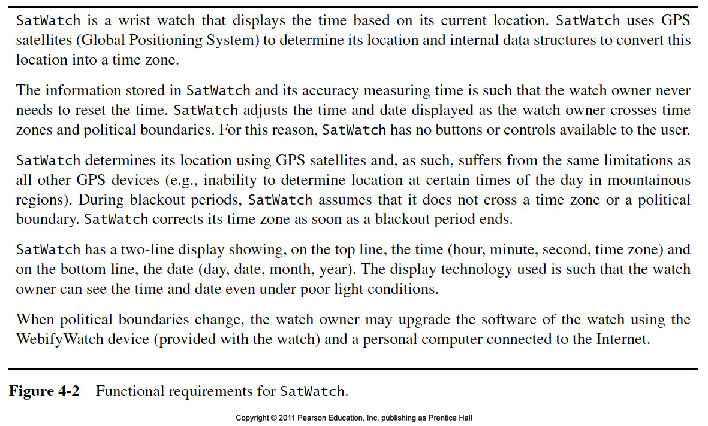

Slide 30
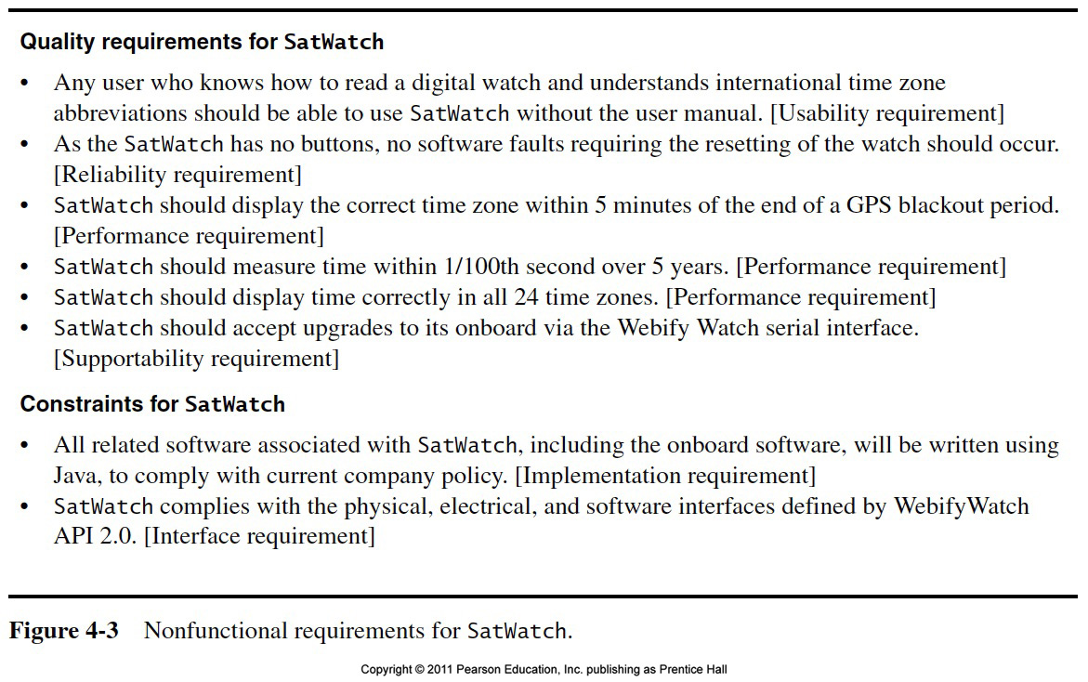

Slide 31
Types of Nonfunctional Requirements
Usability
Reliability
Robustness
Safety
Performance
Response time
Scalability
Throughput
Availability
Supportability
Adaptability
Maintainability
Implementation
Interface
Operation
Packaging
Legal
Licensing (GPL, LGPL)
Certification
Regulation
Constraints or Pseudo requirements
Quality requirements

Slide 32
Some Quality Requirements Definitions
Usability
The ease with which actors can perform a function in a system
Usability is one of the most frequently misused terms (“The system is easy to use”)
Usability must be measurable, otherwise it is marketing
Example: Specification of the number of steps – the measure! - to perform a internet-based purchase with a web browser
Robustness: The ability of a system to maintain a function
even if the user enters a wrong input
even if there are changes in the environment
Example: The system can tolerate temperatures up to 90 C
Availability: The ratio of the expected uptime of a system to the aggregate of the expected up and down time
Example: The system is down not more than 5 minutes per week.

Slide 33
What should not be in the Requirements?
System structure, implementation technology
Development methodology
A rational design process: How and why to fake it (Parnas, 1986)
Development environment
Implementation language
Reusability
It is desirable that none of these above are constrained by the client.

Slide 34
Requirements Validation
Requirements validation is a quality assurance step, usually performed after requirements elicitation or after analysis
Correctness:
The requirements represent the client’s view
Completeness:
All possible scenarios, in which the system can be used, are described
Consistency:
There are no requirements that contradict each other.

Slide 35
Requirements Validation (2)
Clarity:
Requirements can only be interpreted in one way
Realism:
Requirements can be implemented and delivered
Traceability:
Each system component and behavior can be traced to a set of functional requirements
Problems with requirements validation:
Requirements change quickly during requirements elicitation
Inconsistencies are easily added with each change
Tool support is needed!
Notes:
Requirements validation is a quality assurance step, usually after requirements elicitation or analysis.
Completeness:
All possible scenarios, in which the system can be used, are described, including exceptional behavior by the user or the system
Problem with requirements validation:
Requirements change quickly during requirements elicitation.
Inconsistencies are easily added with each change
Tool support is needed!

Slide 36
Different Types of Requirements Elicitation
Greenfield Engineering
Development starts from scratch, no prior system exists, requirements come from end users and clients
Triggered by user needs
Re-engineering
Re-design and/or re-implementation of an existing system using newer technology
Triggered by technology enabler
Interface Engineering
Provision of existing services in a new environment
Triggered by technology enabler or new market needs

Slide 37
Prioritizing Requirements
High priority
Addressed during analysis, design, and implementation
A high-priority feature must be demonstrated
Medium priority
Addressed during analysis and design
Usually demonstrated in the second iteration
Low priority
Addressed only during analysis
Illustrates how the system is going to be used in the future with not yet available technology.

Slide 38
Requirements Analysis Document Template
1. Introduction
2. Current system
3. Proposed system
3.1 Overview
3.2 Functional requirements
3.3 Nonfunctional requirements
3.4 Constraints (“Pseudo requirements”)
3.5 System models
3.5.1 Scenarios
3.5.2 Use case model
3.5.3 Object model
3.5.3.1 Data dictionary
3.5.3.2 Class diagrams
3.5.4 Dynamic models
3.5.5 User interface
4. Glossary

Slide 39
Section 3.3 Nonfunctional Requirements
3.3.1 User interface and human factors
3.3.2 Documentation
3.3.3 Hardware considerations
3.3.4 Performance characteristics
3.3.5 Error handling and extreme conditions
3.3.6 System interfacing
3.3.7 Quality issues
3.3.8 System modifications
3.3.9 Physical environment
3.3.10 Security issues
3.3.11 Resources and management issues

Slide 40
Nonfunctional Requirements (Questions to overcome “Writers block”)
User interface and human factors
What type of user will be using the system?
Will more than one type of user be using the system?
What training will be required for each type of user?
Is it important that the system is easy to learn?
Should users be protected from making errors?
What input/output devices are available
Documentation
What kind of documentation is required?
What audience is to be addressed by each document?

Slide 41
Nonfunctional Requirements (2)
Hardware considerations
What hardware is the proposed system to be used on?
What are the characteristics of the target hardware, including memory size and auxiliary storage space?
Performance characteristics
Are there speed, throughput, response time constraints on the system?
Are there size or capacity constraints on the data to be processed by the system?
Error handling and extreme conditions
How should the system respond to input errors?
How should the system respond to extreme conditions?

Slide 42
Nonfunctional Requirements (3)
System interfacing
Is input coming from systems outside the proposed system?
Is output going to systems outside the proposed system?
Are there restrictions on the format or medium that must be used for input or output?
Quality issues
What are the requirements for reliability?
Must the system trap faults?
What is the time for restarting the system after a failure?
Is there an acceptable downtime per 24-hour period?
Is it important that the system be portable?

Slide 43
Nonfunctional Requirements (4)
System Modifications
What parts of the system are likely to be modified?
What sorts of modifications are expected?
Physical Environment
Where will the target equipment operate?
Is the target equipment in one or several locations?
Will the environmental conditions be ordinary?
Security Issues
Must access to data or the system be controlled?
Is physical security an issue?

Slide 44
Requirement elicitation Activities.
Requirement elicitation includes the following activities:
Identify actors
identify scenarios
Identify use cases
Refining use cases
Identifying relationships among use cases
Identifying non-functional requirements

Slide 45
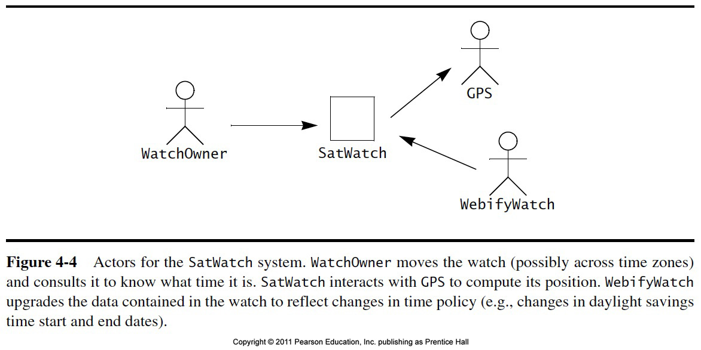
Identifying Actors

Slide 46
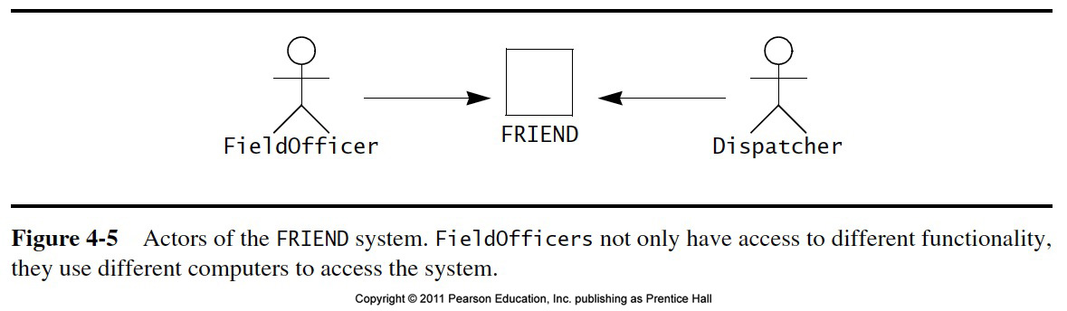
Cont..

Slide 47
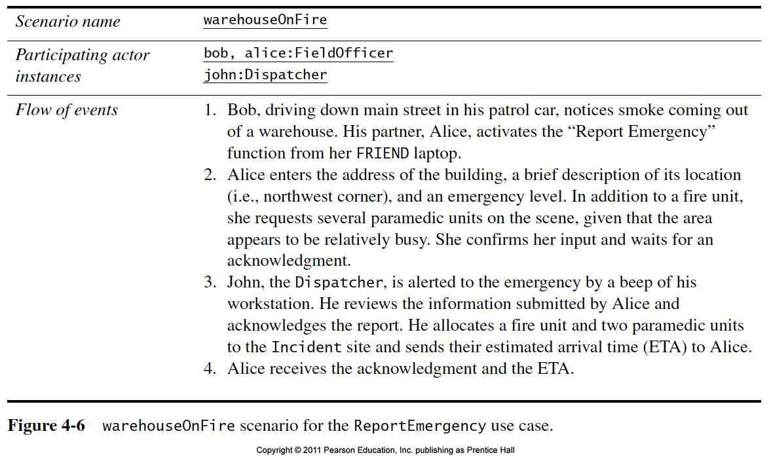
Identifying Scenarios

Slide 48
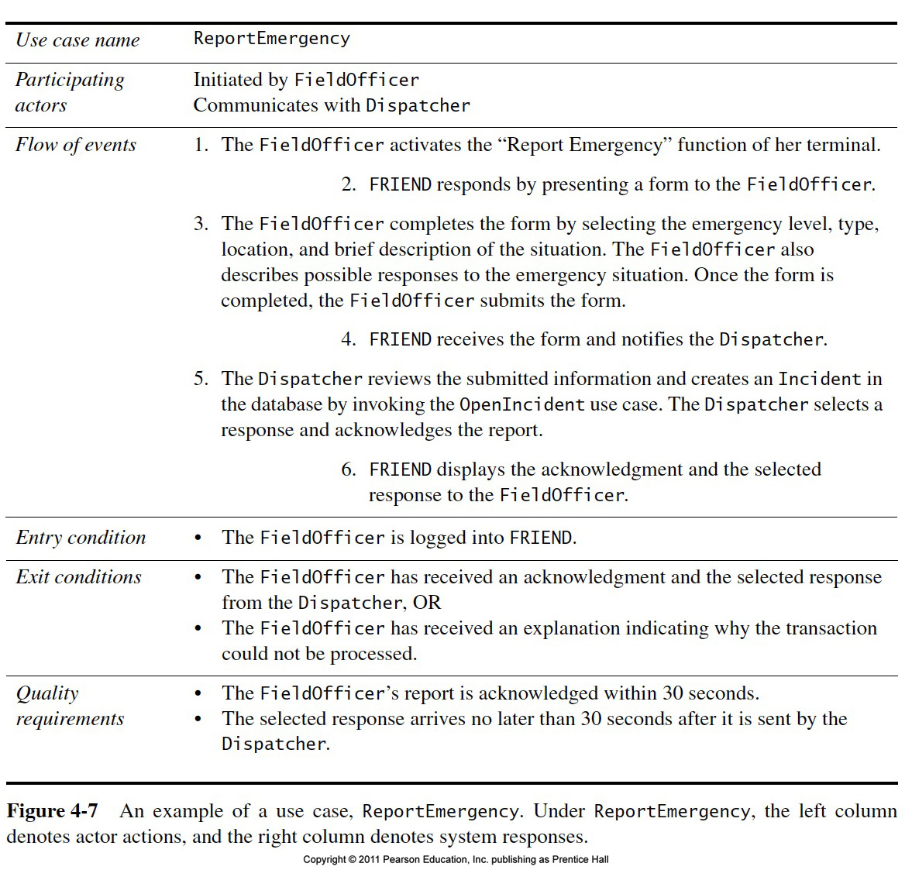
Identifying use cases

Slide 49
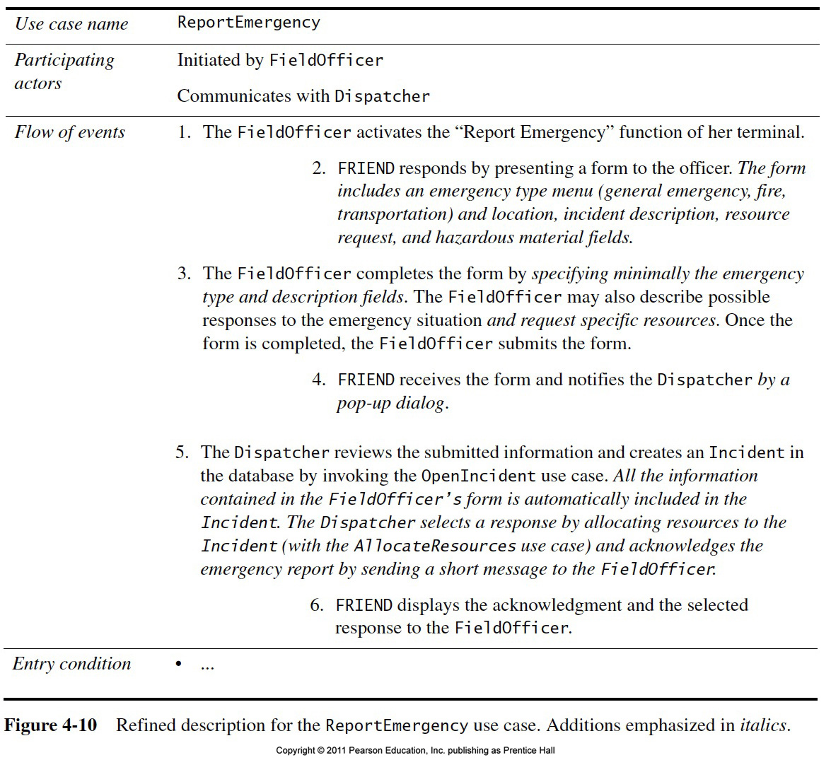
Identifying use cases

